Slide 1



.
CS 112 – Foundations of
Computer Science
Dr. Adriano Cavalcanti
PhD MABE, MS EE, BSc CSc
Computational Nanotechnology & Biomed Robotics
Office location: Hebeler 107 - Phone 509-963-2063
Email: adriano.cavalcanti@cwu.edu
Office hours:
Mon Tue Wed 2:00pm-3:00pm; Or by appointment

Slide 2





CSE A205 Introduction to C Programming for Engineers
Dr. Cavalcanti
a/k/a Dr. Color Candy or Dr. C

Slide 3







Election Program
Notes:
3

Slide 4




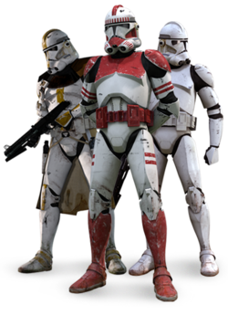

Election Program
Notes:
4

Slide 5



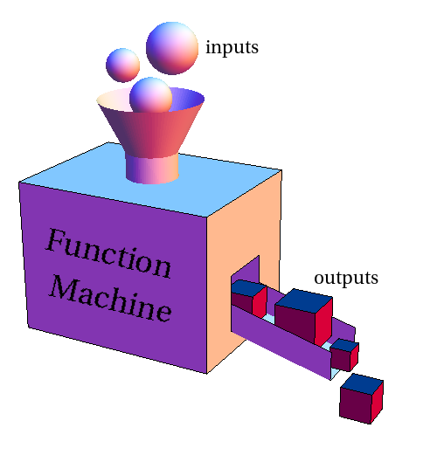



Election Program
Create a class CloneData as your data structure
CloneData
name
timeCounter
Notes:
5

Slide 6
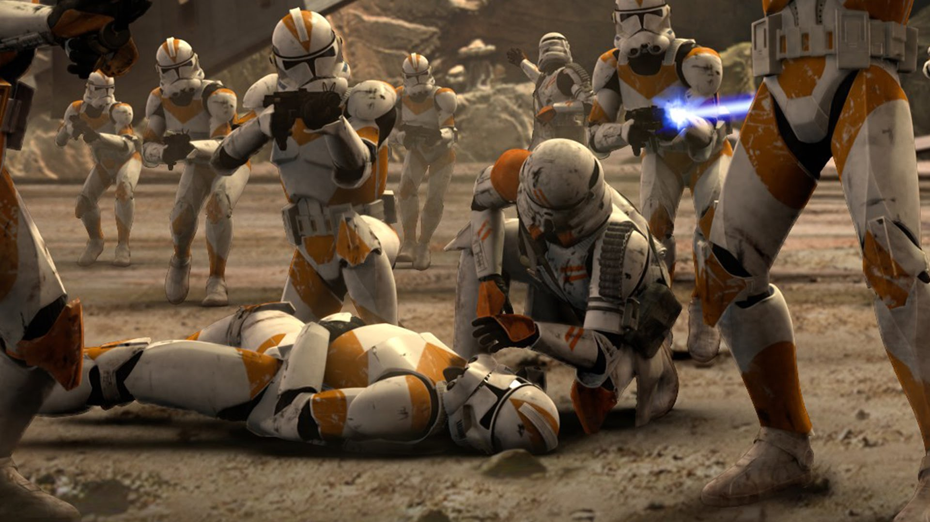
Election Program
Create a class StarWars with methods
StarWars
API
create_clone
input_clone
life_span
Notes:
6

Slide 7

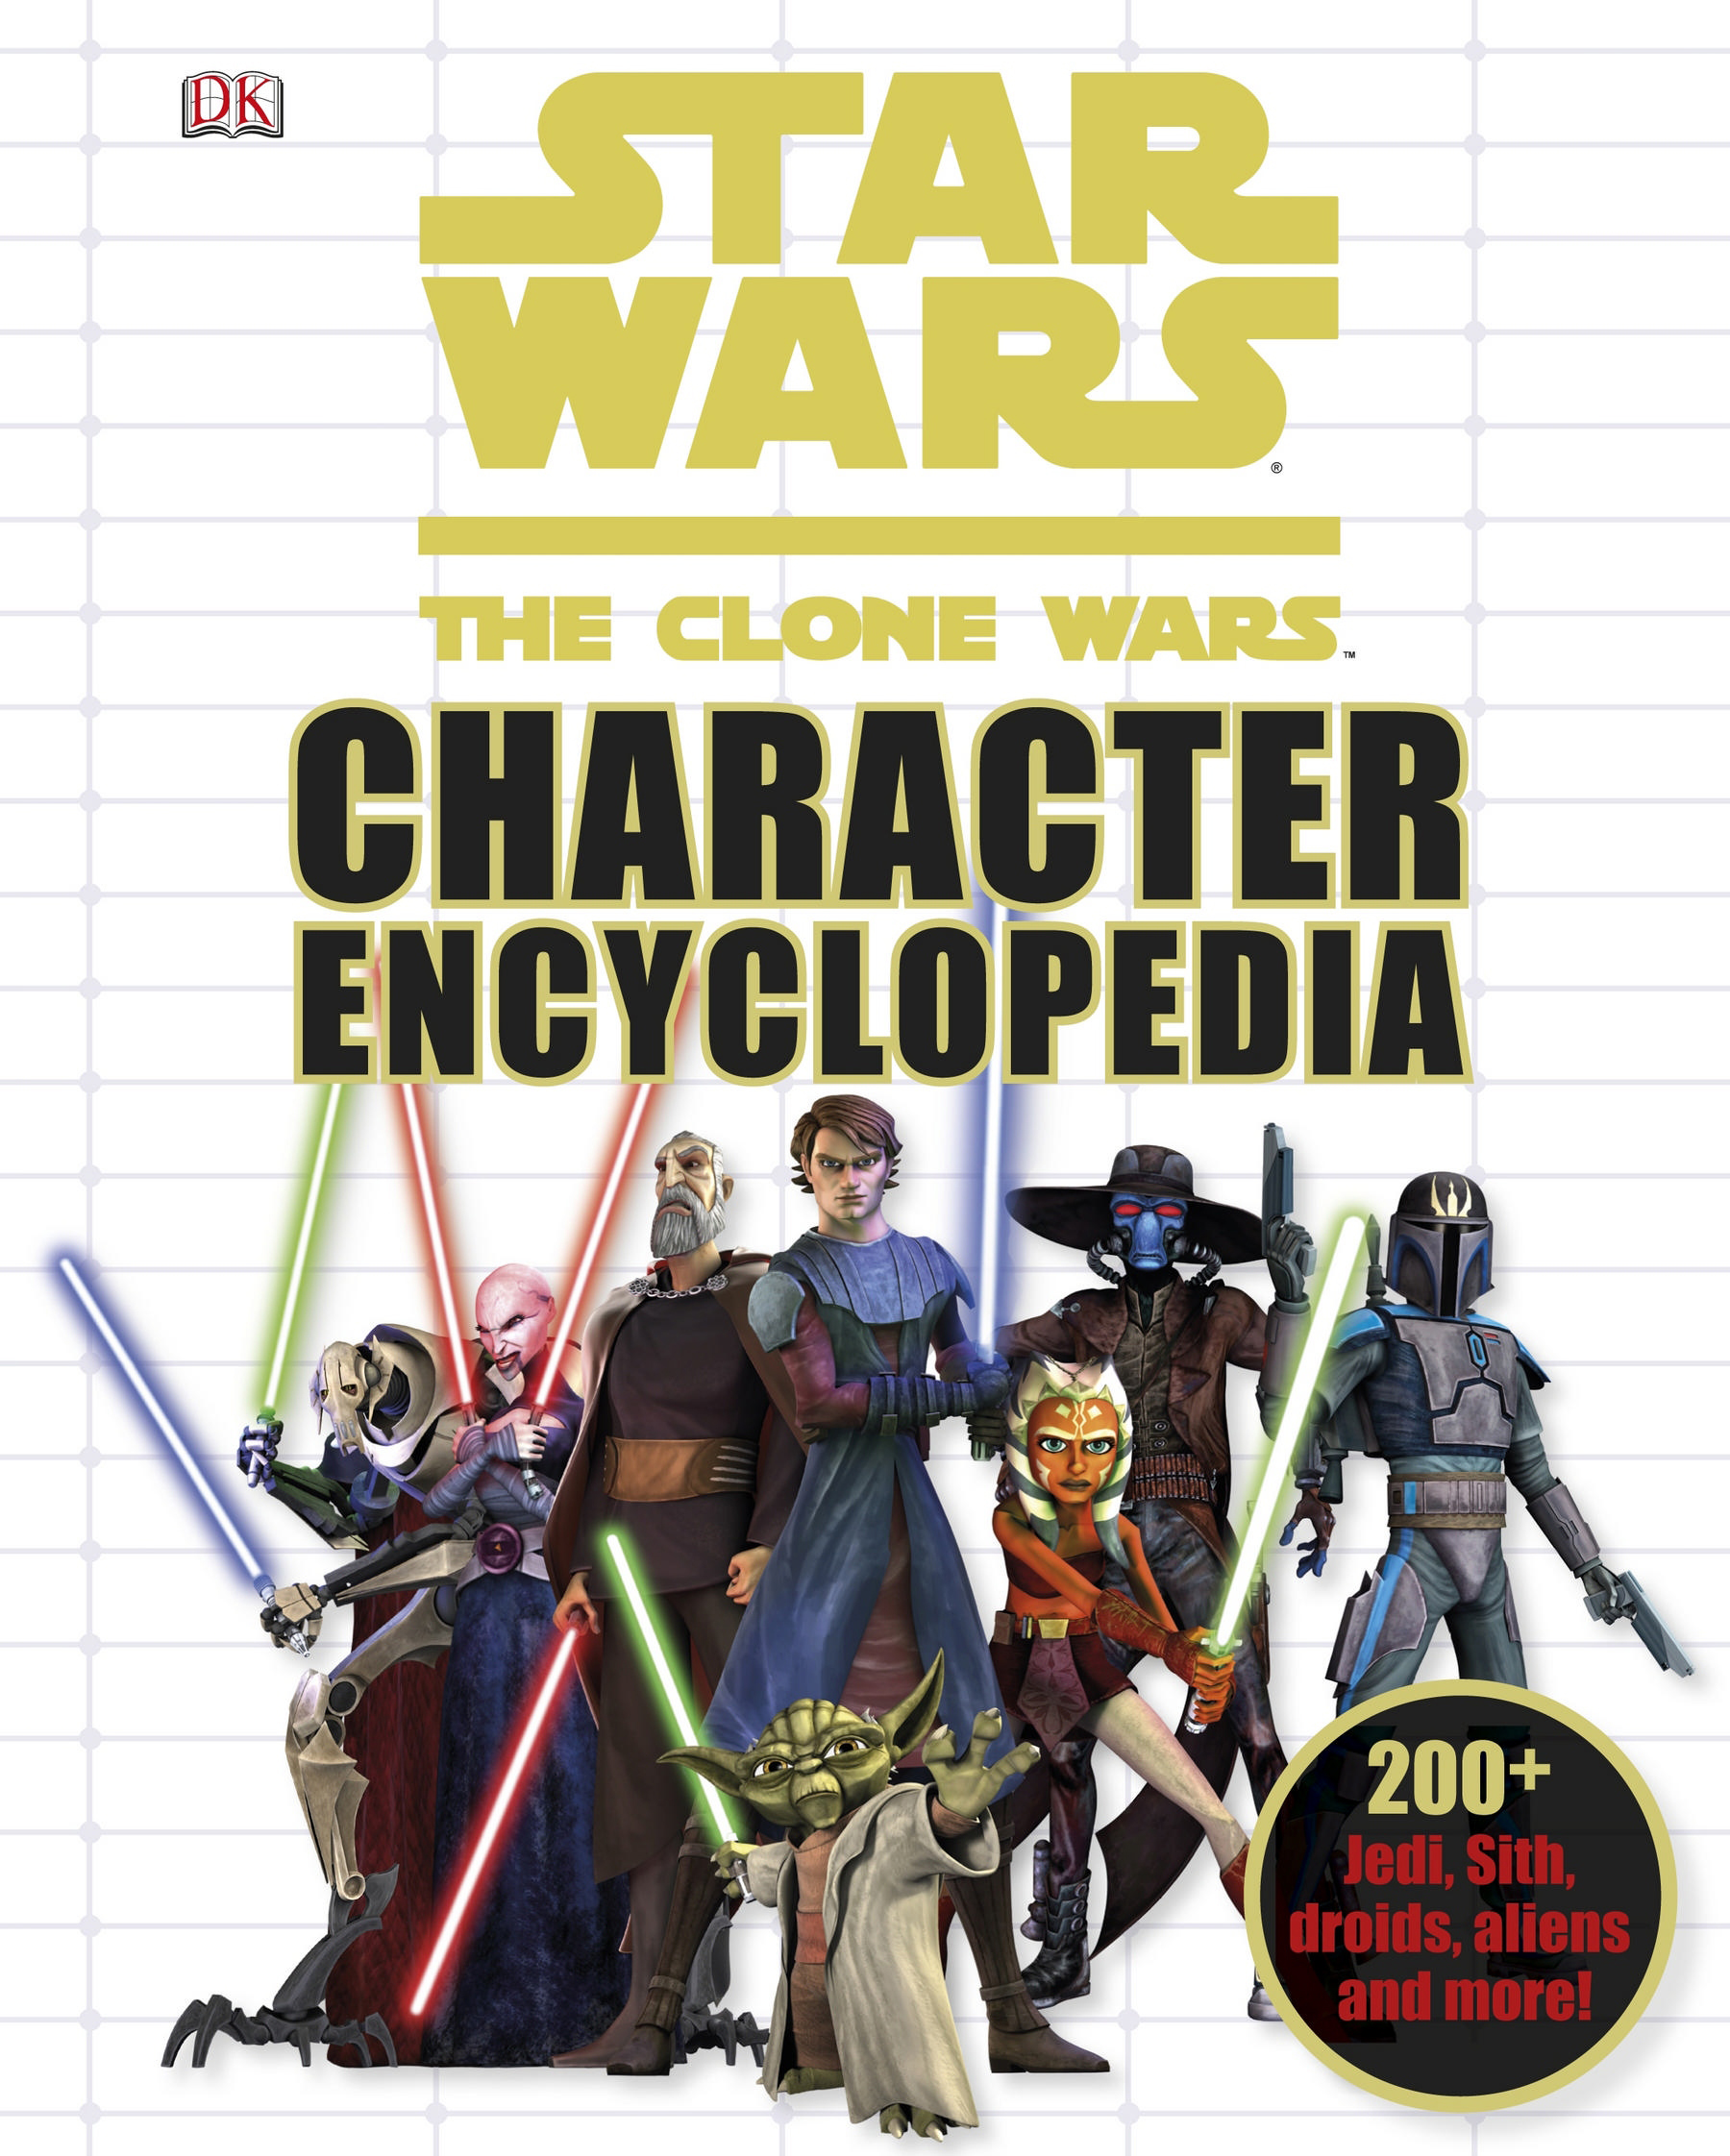
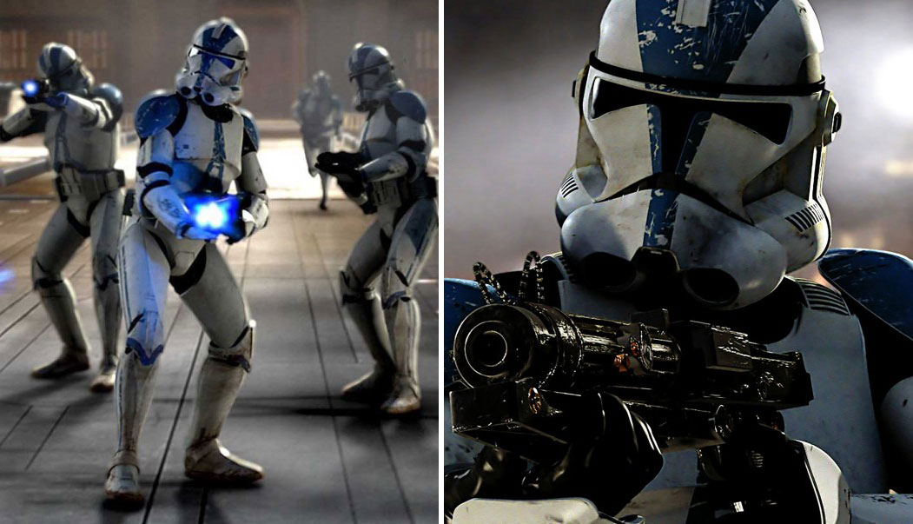


Slide 8




start
API
createClone
inputClones
lifeSpan
end

Slide 9

Create a program with the features:
6) Implement a program that simulates clones creation and lifespan for starWars; the program makes a call to the function named createClone; In createClone you should ask the user about the total_number of clone warrior that should be created, returning it to the function that called it;
7) Your program starWars calls the function inputClones, sendig the total_number of clone warrior asking the user for each of the clones, warrior[i].name and warrior[i].timeCounter; the function inputClones return to the function that called it the information for all clone using struct.
8) As clones are believed to have a shorter lifespan, make a call to the function lifeSpan, sending to the function lifeSpan the respective warrior information such as warrior[i].name and warrior[i].timeCounter for each clone; run the function lifeSpan with a loop counting the biological clock from each clone as follow: every loop iteration, print the warrior name and timeCounter; the timeCounter is decreased by 1 in each iteration; if for that clone timeCounter is zero print name and timeCounter with the message: “The clone NAME with TIMER is dead”, or “The clone NAME with TIMER is alive” if timeCounter is larger and zero (where NAME and TIMER is the respective name and lifespan/time from the respective clone); inform when all clones are dead, then finish the program.

Slide 10

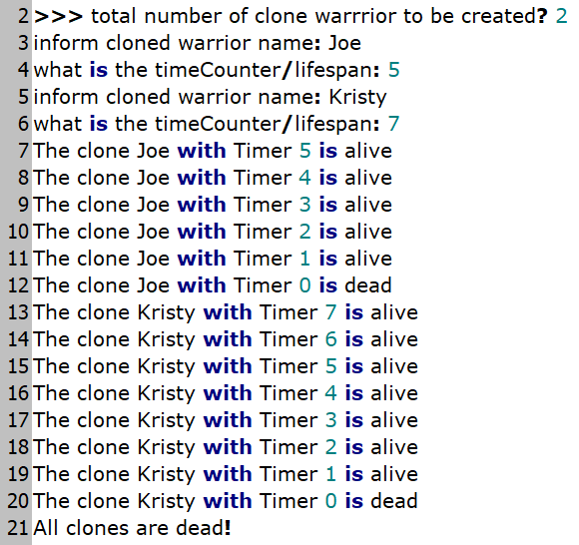


Slide 11

Dr. Cavalcanti
a/k/a Dr. Color Candy or Dr. C

